Slide 1
Nigeria-covid-19-data-analysis-using-python
Data scientist microdegree capstone project
By edeh mary

Slide 2
CONTENT
OVERVIEW
DATA SOURCES
DATA COLLECTION
DATA CLEANING AND PREPROCESSING
ANALYSIS
INSIGHTS AND CONCLUSION

Slide 3
OVERVIEW
Coronavirus disease (COVID-19) is an infectious disease caused by a newly discovered coronavirus and it has affected many parts of the world.
Nigeria, a West-African country with 37 states was also affected by COVID-19 as this pandemic led to shutting down major airports, a nation-wide lockdown and curfews which in turn devastated the economy.
The goal of this project is to perform analysis to answer questions and generate insights.

Slide 4
DATA SOURCES
NCDC WEBSITE: THE NIGERIAN CENTRE FOR DISEASE CONTROL WAS RESPONSIBLE FOR MONITORING THE COVID-19 SITUATION IN NIGERIA AND RELEASING DATA ON METRICS ON THE 37 STATES- FEDERAL REPUBLIC TERRITORY INCLUDED. THIS DATA WAS EXTRACTED FROM THE OFFICIAL NCDC WEBSITE THROUGH WEB SCRAPING AND WEB EXTRACTION.
JOHNS HOPKINS GITHUB REPOSITORY: THE CENTRE FOR SYSTEMS SCIENCE AND ENGINEERING (CSSE) AT JOHNS HOPKINS UNIVERSITY PUBLISHES DAILY DATA ON GLOBAL CONFIRMED, RECOVERED AND DEATH CASES FROM COUNTRIES AROUND THE WORLD. THE DATA FROM NIGERIA IS EXTRACTED FOR ANALYSIS AND TO DERIVE INSIGHTS.

Slide 5
DATA SOURCES
EXTERNAL DATA: DATA FROM OUTSIDE SOURCES
NIGERIA COVID DATA: NIGERIA COMMUNITY VULNERABILITY INDEX
BUDGET DATA: NEW AND REVISED STATE BUDGET DATA DURING COVID PANDEMIC FOR ALL 36 STATES.
GDP DATA: GROSS DOMESTIC PRODUCT DATA FROM Q1 TO Q4 IN THE YEAR 2020.

Slide 6
DATA COLLECTION
DATA FROM THE NCDC WEBSITE (https://covid19.ncdc.gov.ng/) IS EXTRACTED THROUGH WEB SCRAPING.
JOHNS HOPKINS DATA: THE DATA IS EXTRACTED FROM THE GITHUB REPOSITORY.
EXTERNAL DATA: COMMUNITY VULNERABILITY INDEX DATA, STATE BUDGET DATA, AND GDP DATA IS EXTRACTED FROM LOCAL SOURCES.

Slide 7
DATA CLEANING AND PREPARATION
COMMAS AND WHITESPACES WERE REMOVED TO MAKE THE DATA MORE REFINED.
THE DATA WAS ACCURATELY CONVERTED TO THEIR APPROPRIATE FORMAT TO ENSURE ACCURATE DATA ANALYSIS.
DATA WAS CAREFULLY EXTRACTED FROM DATAFRAMES TO CONDUCT ANALYSIS.

Slide 8
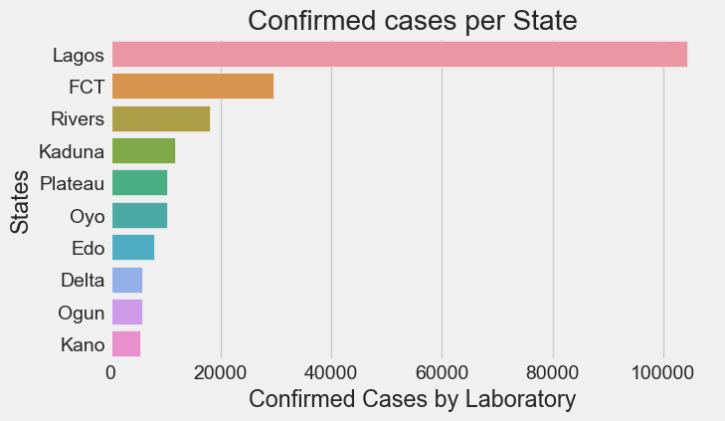
ANALYSIS
THE FOLLOWING CHART SHOWS THE TOP 10 STATES WITH THE HIGHEST CASES OF COVID-19 CONFIRMED BY LABORATORY TEST.
LAGOS STATE HAS THE HIGHEST NUMBER OF CONFIRMED COVID-19 CASES, FOLLOWED BY FCT AND RIVERS STATE

Slide 9
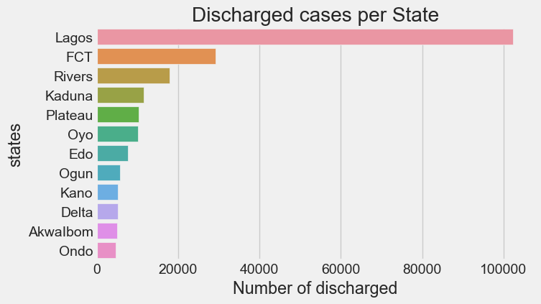
ANALYSIS
THE PLOT SHOWS THE TOP TEN STATES IN TERMS OF DISCHARGED COVID-19 CASES
LAGOS HAD THE HIGHEST AMOUNT OF DISCHARGED CASES, FOLLOWED BY FCT AND RIVERS STATE

Slide 10
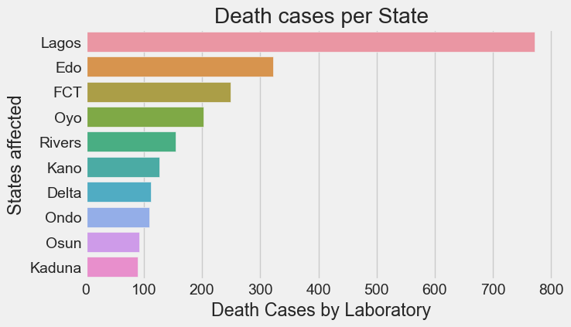
ANALYSIS
THE FOLLOWING CHART SHOWS THE TOP TEN DEATH CASES BY STATE.
LAGOS STATE HAS THE HIGHEST AMOUNT OF DEATH CASES, FOLLOWED BY EDO STATE AND FCT.

Slide 11
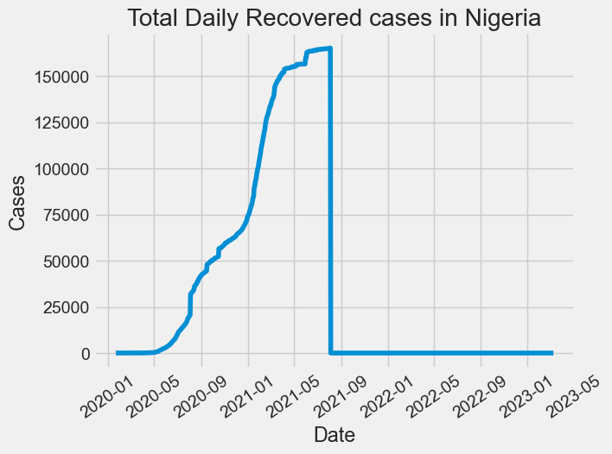
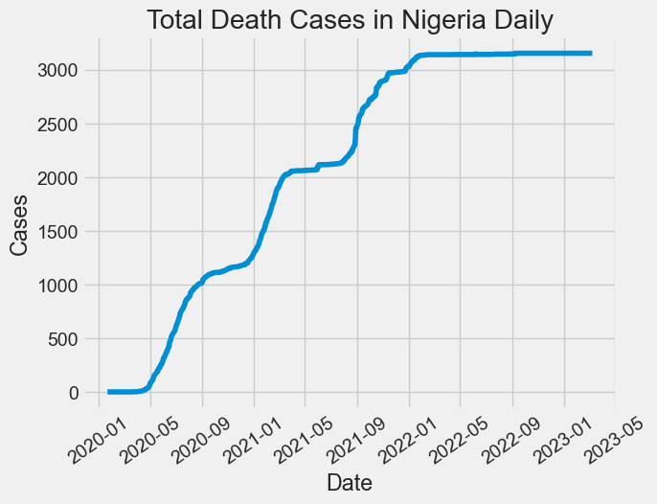
COMPARISON BETWEEN TOTAL DAILY RECOVERED CASES AND TOTAL DAILY DEATH CASES.

Slide 12
ANALYSIS
FROM THE ABOVE SLIDES, WE CAN DETERMINE THAT AS THE RECOVERED CASES WENT LOW, THE NUMBER OF DEATH CASES WERE AT AN ALL TIME HIGH.

Slide 13
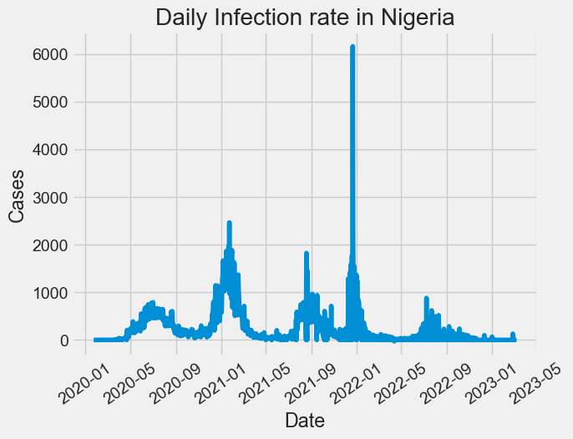
ANALYSIS
ON THE 22ND OF DECEMBER, 2021, NIGERIA RECORDED THE HIGHEST AMOUNT OF NEW CASES: 6,158.

Slide 14
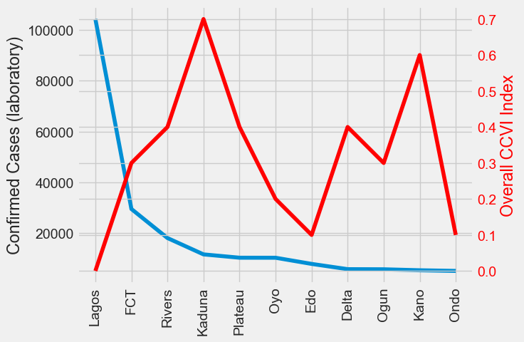
ANALYSIS
THE FOLLOWING CHART SHOWS THE TOP TEN STATES WITH CONFIRMED CASES, AS COMPARED TO THE COMMUNITY VULNERABILITY INDEX.

Slide 15
ANALYSIS
FROM THE ABOVE PLOT, WE CAN DEDUCE THAT LAGOS HAS THE LOWEST CCVI INDEX DESPITE HAVING THE HIGHEST AMOUNT OF CONFIRMED CASES. THIS IS A RESULT OF THE ADEQUATE MEDICAL IINFRASTRUCTURE IN THE STATE.
KADUNA HAS THE HIGHEST CCVI INDEX DESPITE HAVING AN AVERAGE AMOUNT OF CONFIRMED COVID-19 CASES. THIS IS A AS A RESULT OF THE MEDIOCRE MEDICAL SYSTEM AND INFRASTRUCTURE. THIS CAN ALSO BE SAID FOR NORTHERN STATES IN GENERAL.

Slide 16
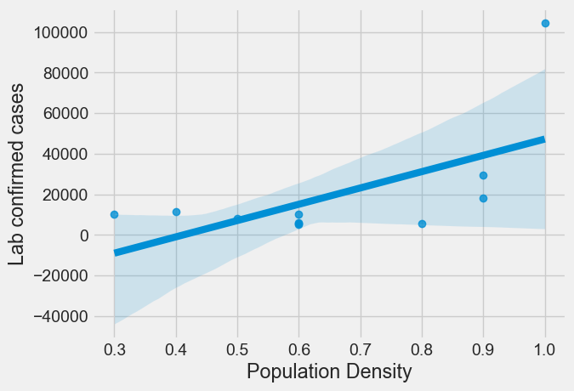
ANALYSIS
THE FOLLOWING PLOT SHOWS THE RELATIONSHIP BETWEEN LAB CONFIRMED CASES AND POPULATION DENSITY

Slide 17
ANALYSIS
FROM THE PLOT ABOVE, WE SEE A POSITIVE CORRELATION BETWEEN COVID-19 LAB CONFIRMED CASES AND AREAS THAT ARE DENSELY POPULATED. THIS MEANS THAT THERE ARE HIGH CASES OF LAB CONFIRMED CASES IN AREAS THAT ARE DENSELY POPULATED I.E AREAS WHERE MANY PEOPLE LIVE COMPARED TO THE AVERAGE OCCUPANCY

Slide 18
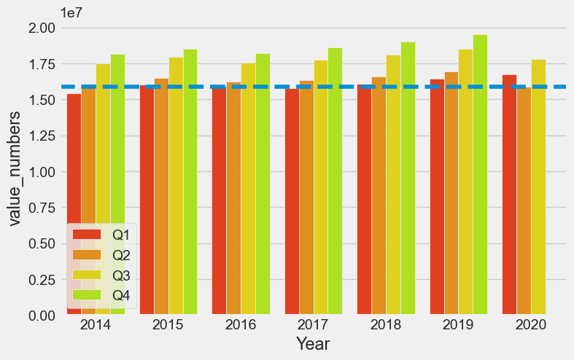
ANALYSIS
THE FOLLOWING CHART SHOWS THE GDP VALUE OF NIGERIA PRE COVID AND THE GDP VALUE DURING COVID.

Slide 19
analysis
FROM THE ABOVE CHART, WE CAN SEE THAT THE Q2 OF THE YEAR 2020 HAD THE LOWEST GDP EVER RECORDED. THIS WAS DUE TO THE LOCKDOWN AND THE RESTRICTIONS WHICH WERE PLACED ON PEOPLE AND BUSINESSES, THEREBY HINDERING THE GROWTH OF THE ECONOMY.

Slide 20
CONCLUSION
LAGOS STATE HAD THE HIGHEST NUMBER OF LABORATORY CONFIRMED CASES.
LAGOS STATE HAD THE HIGHEST NUMBER OF DISCHARGED CASES.
THEY WERE DAILY INCREMENTS OF CONFIRMED, RECOVERED AND DEATH CASES IN THE YEAR 2020.
THE MAXIMUM INFECTION RATE RECORDED 6,158 NEW CASES ON THE 22ND OF DECEMBER,2021.

Slide 21
CONCLUSION
NORTHERN STATES HAS THE HIGHEST VULNERABILITY INDEX DESPITE HAVING AN AVERAGE AMOUNT OF CONFIRMED CASES DUE TO IT’S WEAK HEALTH SYSTEM
LAGOS STATE HAD THE HIGHEST VULNERABILITY INDEX DESPITE HAVING THE HIGHEST AMOUNT OF CONFIRMED CASES AS A RESULT OF AN ADEQUATE HEALTH SYSTEM AND THE PERFORMANCE OF SOCIAL DISTANCING.
CONFIRMED COVID-19 CASES AND POPULATION DENSITY HAVE A POSITIVE CORRELATION. THIS MEANS THAT THERE ARE HIGH RATES OF LAB CONFIRMED CASES IN AREAS THAT ARE DENSELY POPULATED.
THE SECOND QUARTER OF 2020 WAS RELATIVELY LOW COMPARED TO THE SECOND QUARTER OF RECENT YEARS AS A RESULT OF THE EFFECTS OF COVID-19.

